Slide 1
Why make transistors smaller, And why is Moore’s law the case?
Tackling each question individually, by Daniel Wilcox

Slide 2
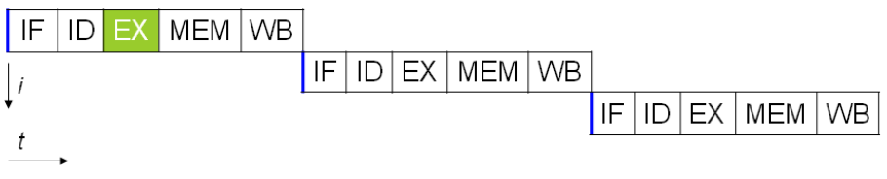
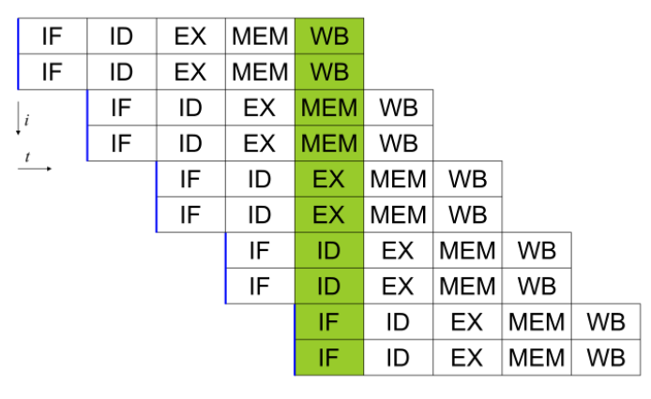
Sub-scalar vs. Super-scalar [4]
i-axis represents number of instructions
t-axis represents number of cycles
scalar design [11]
Super-scalar [14]
- 3 instructions, 15 total cycles
- 10 instructions, 9 cycles
- Introduced in 1988 as a result of Moore’s Law’s success and innovation of CPU designs [10]
Increasing the instruction/cycle ratio is vital to efficient CPU design, as well as software design

Slide 3

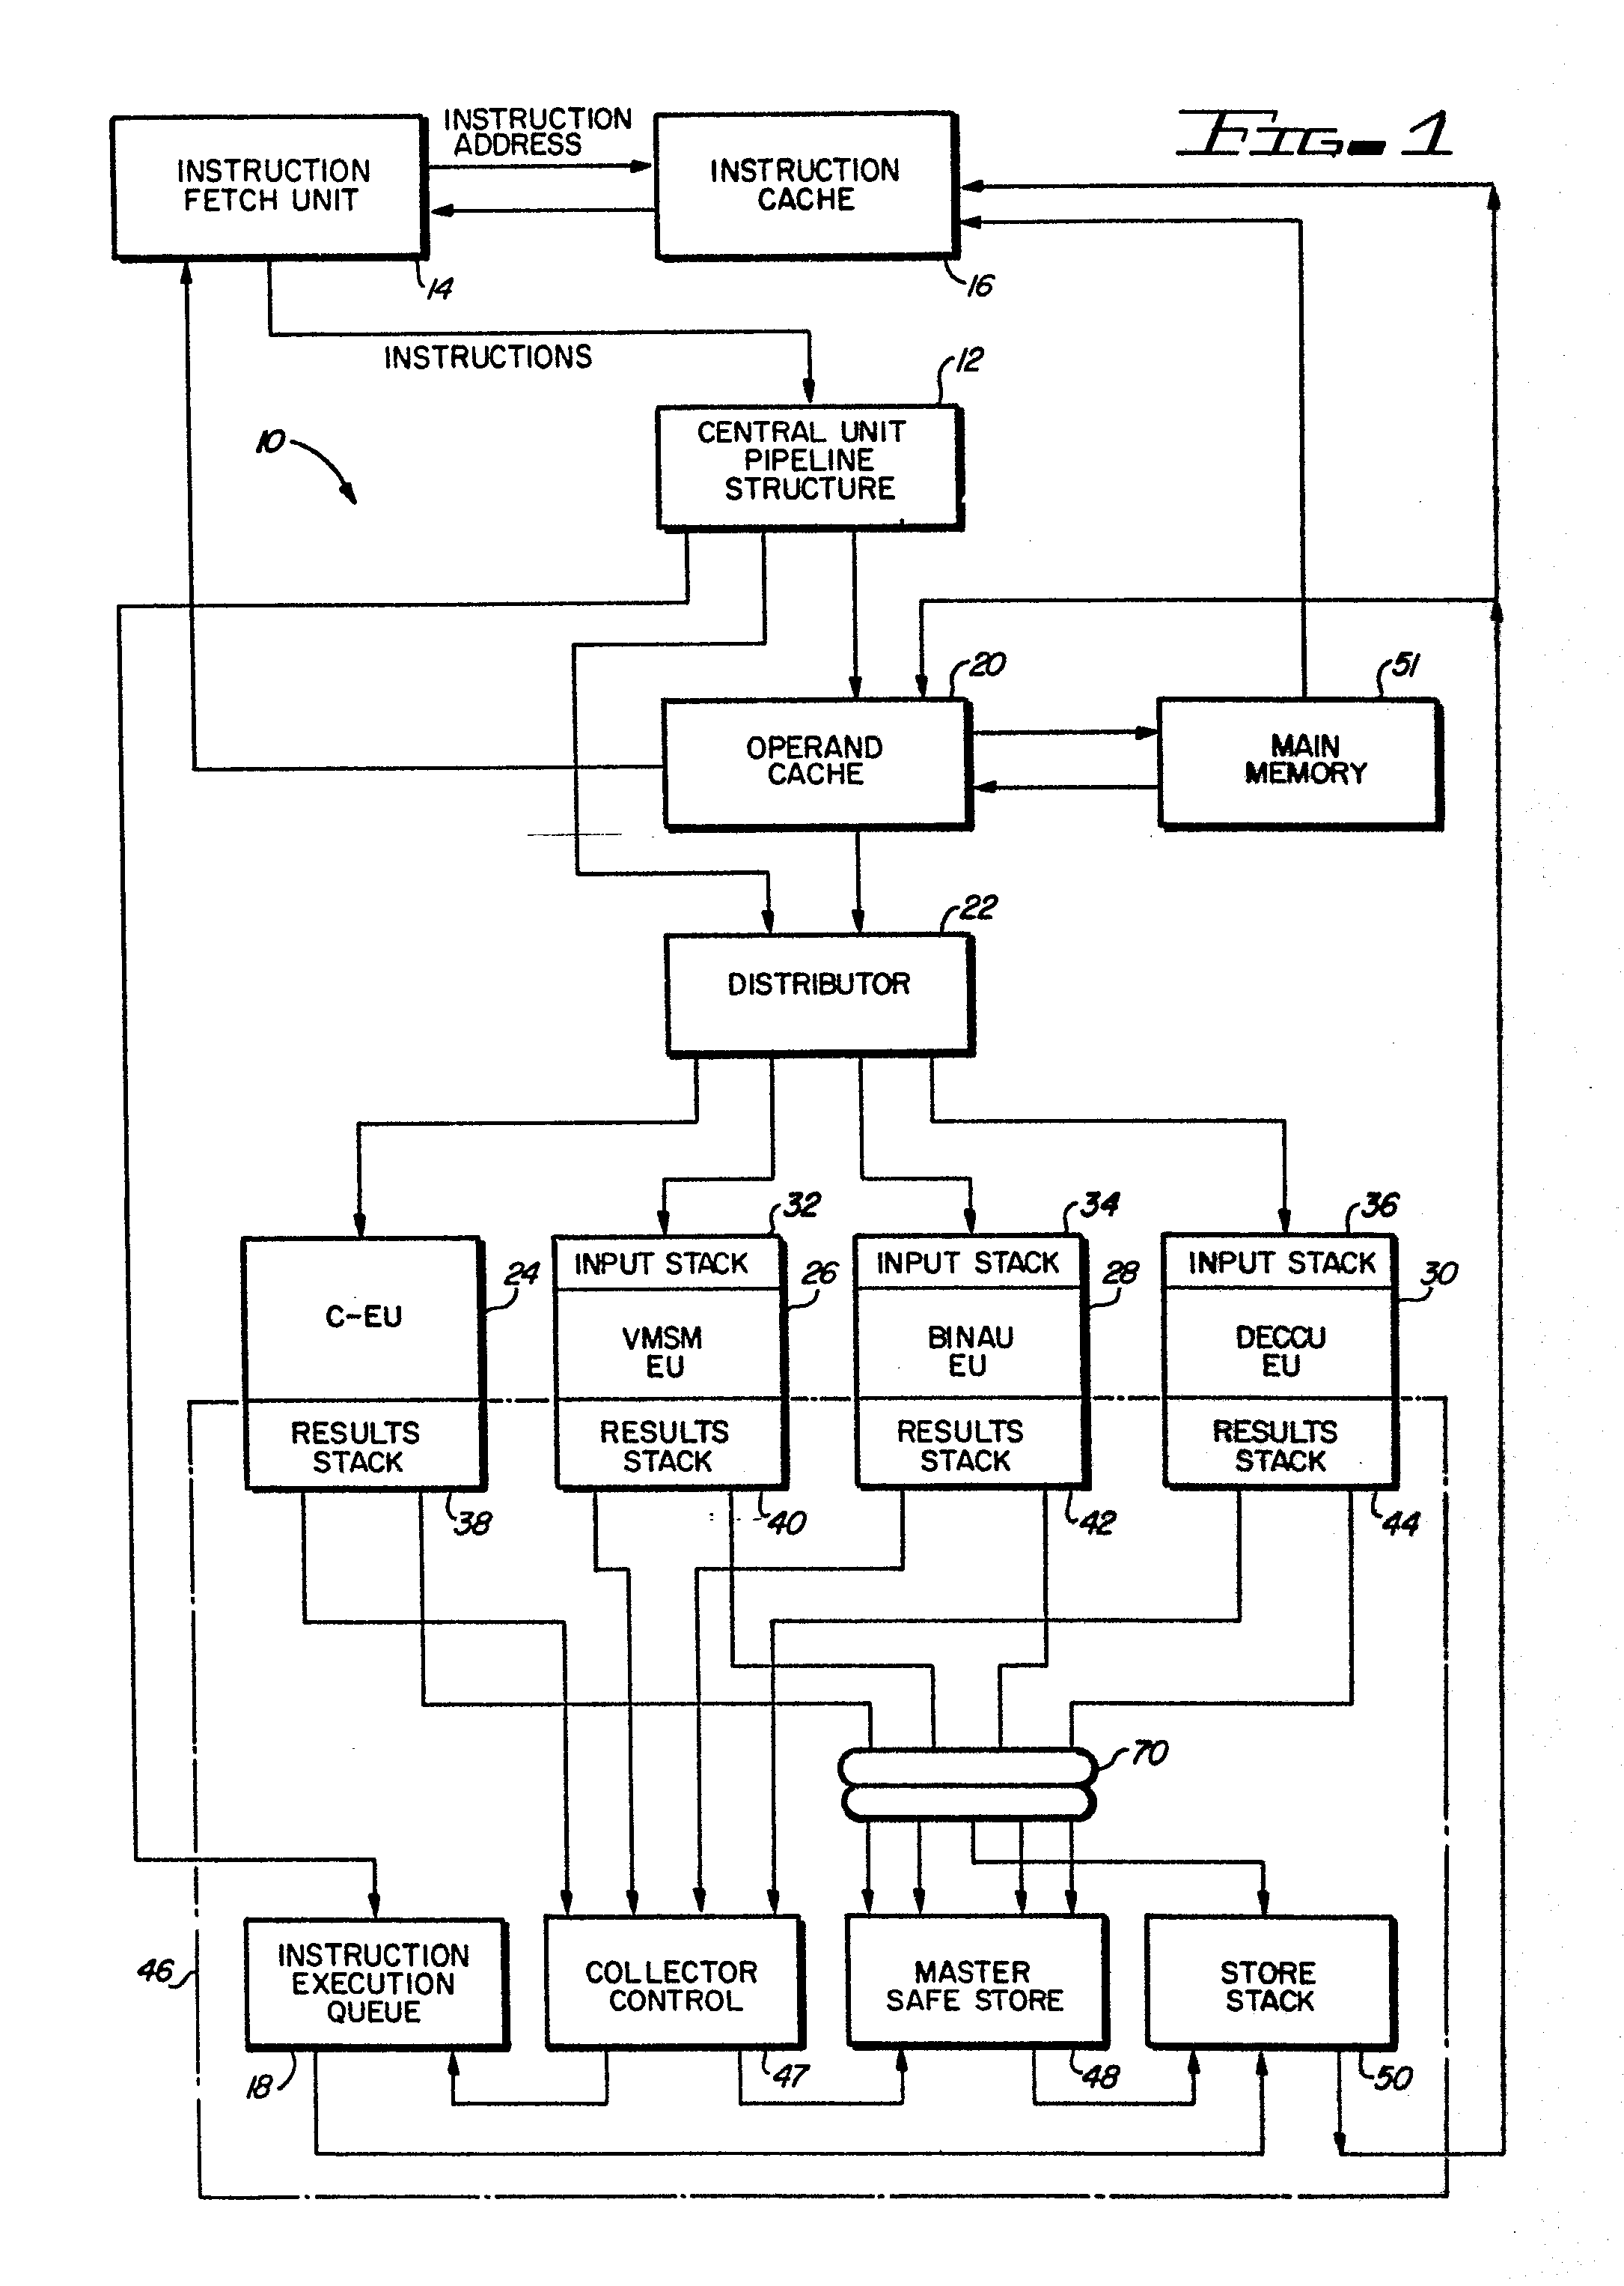
Example: Superscalar CPU [7]
Instructions (programs) are fetched
Instructions pipelined into the distributor
Distributor runs segments of instructions, known as “queues,” into execution units (marked EU on diagram)
Results are produced and controlled
Figure is of a Google patent from 1984 [7], designing a CPU with multiple execution units.

Slide 4

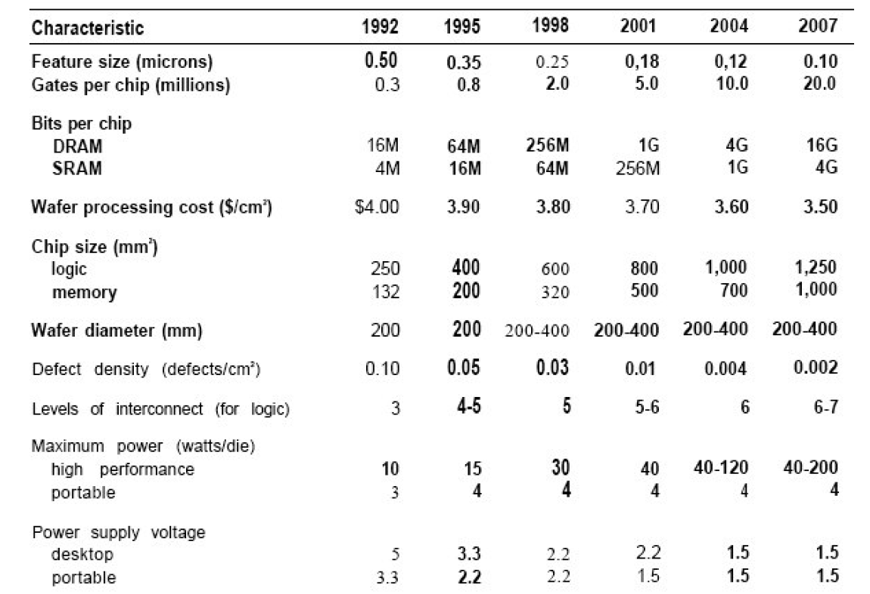

Semiconductor Roadmap [12]
Feature size decreases
Number of gates increases
Wafer size remains constant
3-year intervals
Gates per chip increments:
$$0.3∗2^{1.5}=0.84$$
$$0.8∗2^{1.5}=2.26$$
$$2∗2^{1.5}=5.65$$
Equations demonstrate that the gates per chip roughly follows Moore’s law (slightly less, but still consistent)

Slide 5
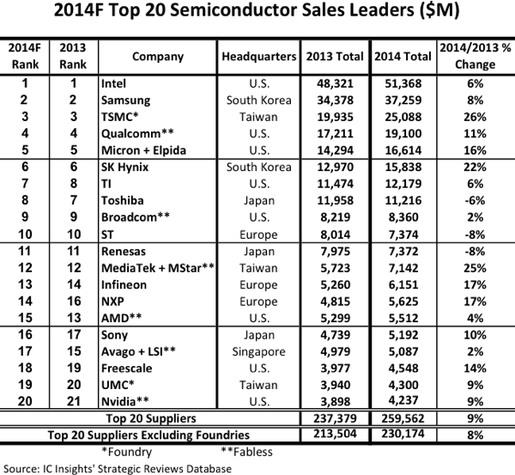
Enforcing the law [9] [13]
Intel continues to lead the semiconductor industry, even now
Intel wasn’t majorly successful in the marketplace until the early 1990s, when the 386 microprocessor was released and dominated the market
Despite this, the introduction and constant focus on microprocessor manufacturing created competition with IBM and, later, AMD
Success in the market was not instantaneous, but after years of patience and consistency, Intel not only created the semiconductor market, but dominated it too

Slide 6
Cited Sources (via Google Scholar)
1. Palcharla, Subbarao, et al. “Complexity-Effective Superscalar Processors.” Complexity-Effective Superscalar Processors | Proceedings of the 24th Annual International Symposium on Computer Architecture, ISCA '97: Proceedings of the 24th Annual International Symposium on Computer Architecture, 1 May 1997, dl.acm.org/doi/abs/10.1145/264107.264201.
2. Fite, Elaine H. “US5067069A - Control of Multiple Functional Units with Parallel Operation in a Microcoded Execution Unit.” Google Patents, Google, 3 Feb. 1989, patents.google.com/patent/US5067069A/en.
3. Kanter, David. “Intel's Haswell CPU Microarchitecture.” Real World Tech, 13 Nov. 2012, www.realworldtech.com/haswell-cpu/4/.
4. “Reading: The Central Processing Unit.” Lumen, courses.lumenlearning.com/zeliite115/chapter/reading-the-central-processing-unit/.
5. “22nm Technology Backgrounder.” OVER 6 DECADES OF CONTINUED TRANSISTOR SHRINKAGE, INNOVATION, May 2011.
6. Moore, Gordon E. “Cramming More Components Onto Integrated Circuits.” Proceedings of the IEEE, vol. 86, no. 1, 19 Apr. 1965, pp. 82–85., doi:10.1109/jproc.1998.658762.
7. Guenthner, Russell W. “EP0106670A2 - CPU with Multiple Execution Units.” Google Patents, Google, 1984, patents.google.com/patent/EP0106670A2/en.
8. Gulett, Mike. “Moore's Law Is Not Really A Law But It Is Still Obeyed.” Medium, Data Driven Investor, 29 Apr. 2019, medium.com/datadriveninvestor/moores-law-is-not-really-a-law-but-it-is-still-obeyed-2e0c2b596525.
9. Maliniak, Lisa. “Ten Notable Flops: Learning From Mistakes.” ElectronicDesign, ElectronicDesign, 21 Oct. 2002, www.electronicdesign.com/technologies/boards/article/21772296/ten-notable-flops-learning-from-mistakes.
10. Johnson, Mike. Superscalar Microprocessor Design. Prentice Hall, 1991.
11. “Model of a Subscalar CPU.” Reading: The Central Processing Unit, Lumen Learning, 2010, courses.lumenlearning.com/zeliite115/chapter/reading-the-central-processing-unit/.
12. Semiconductor Industry Association, 1993. The First Semiconductor Roadmap, Released In 1993 By The SIA. [Image].
13. “2014F Top 20 Semiconductor Sales Leaders.” IC Insight's Strategic Reviews Database, IC Insights, 2014, www.icinsights.com/.
14. “A Simple Superscalar Pipeline.” Reading: The Central Processing Unit, Lumen Learning, 2010, courses.lumenlearning.com/zeliite115/chapter/reading-the-central-processing-unit/.

